Slide 1

Strategies for Restaurant Expansion

Slide 2
Expansion Strategies for New Restaurants
Welcome to an exciting phase of growth as we embark on the journey of expanding our restaurant family. As the appetite for our unique culinary experiences continues to grow, we are thrilled to present strategic insights and suggestions that will pave the way for the successful launch of new restaurants. In this presentation, we will explore innovative approaches, market analysis, and operational considerations to ensure a seamless and prosperous expansion. Let's dive into the strategies that will not only capture new markets but also solidify our position as a culinary leader in the industry.

Slide 3
Number of restaurants opened in each year
Explore the chart showcasing the number of restaurants opened in each country. It's a visual testament to our data-driven strategies, providing a clear overview of our global restaurant footprint.
This chart illustrates the dynamic landscape we've navigated, setting the stage for informed decisions and strategic expansion.
Year

Slide 4
Average Ratings Of Restaurants In Each Country
Ratings Snapshot
Explore the average restaurant ratings across different countries, a simple yet powerful indicator guiding our expansion strategy. Join us as we decipher the ratings landscape and chart our course towards international culinary success.

Slide 5
Average number of voters in each country
Voter Engagement Insights
Explore the chart depicting the average number of voters for each country. This snapshot reveals the level of engagement within each location, offering valuable insights into community interaction.
Our data-driven approach ensures we're not just opening restaurants; we're fostering connections and making a meaningful impact.
Country

Slide 6
Suggestions for Newer Restaurants
Optimal Expansion Spots: Based on careful analysis, I recommend considering Canada, Singapore, Sri Lanka and Australia for new restaurant openings. These countries show promising signs of potentially lower competition.
Justification Through Visualization: To arrive at this conclusion, I employed a specialized visualization technique. By examining factors like average ratings and fewer restaurants.

Slide 7
Current Quality of Restaurants in Suggested Countries
Understanding the current quality of restaurants in our target countries is pivotal to our expansion strategy. The accompanying bar chart offers a visual insight into the dining landscape, depicting the varying levels of culinary excellence across suggested regions. This snapshot enables us to identify opportunities and areas for improvement, ensuring that our new establishments not only meet but exceed local expectations. Let's delve into this analysis to lay the foundation for elevating the dining experience in our upcoming ventures.

Slide 8
Restaurant Price Range Distribution Across Countries
Gain a nuanced perspective on the culinary market with our comprehensive chart showcasing the distribution of restaurants across different price ranges in various countries. This visual insight illuminates the diversity in pricing structures, empowering us to tailor our approach for each locale. As we analyze the data, we'll uncover opportunities to offer a spectrum of dining experiences, ensuring our expansion aligns seamlessly with the preferences and expectations of diverse markets.

Slide 9
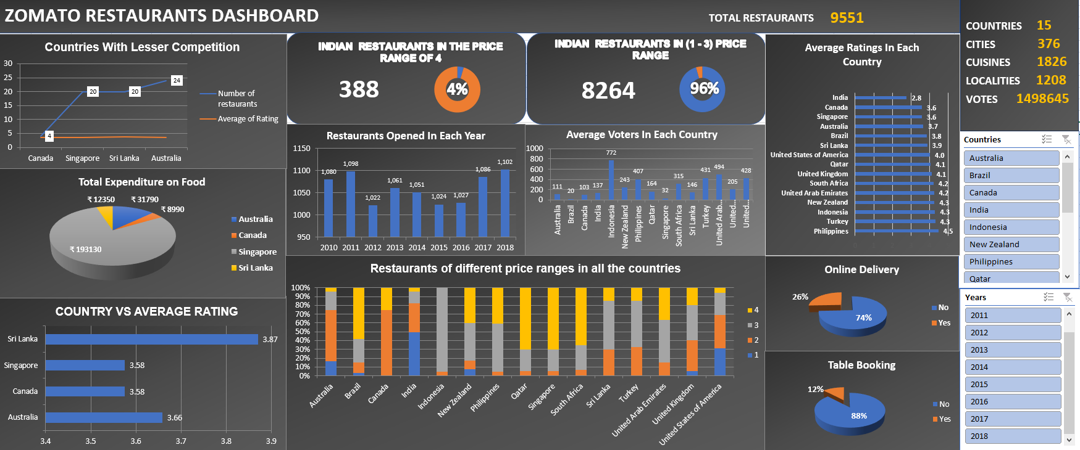
RESTAURANTS DASHBOARD

Slide 10
Conclusion
Key Findings
Explored and cleaned our restaurant data.
Uncovered countries with potential for new restaurant ventures.
Utilized a robust visualization technique to identify optimal locations.
Analyzed average ratings, votes, and total restaurant counts for strategic insights.
Recommendations
Consider venturing into Canada, Singapore , Sri Lanka and Australia for potentially lower competition.
Leverage the visualization techniques employed for more informed decision-making.

Slide 11


